Slide 1
CLOUD FEDERATION
Are We There Yet?

Slide 2
Why Do We Federate?
Tim Bell - CERN

Slide 3
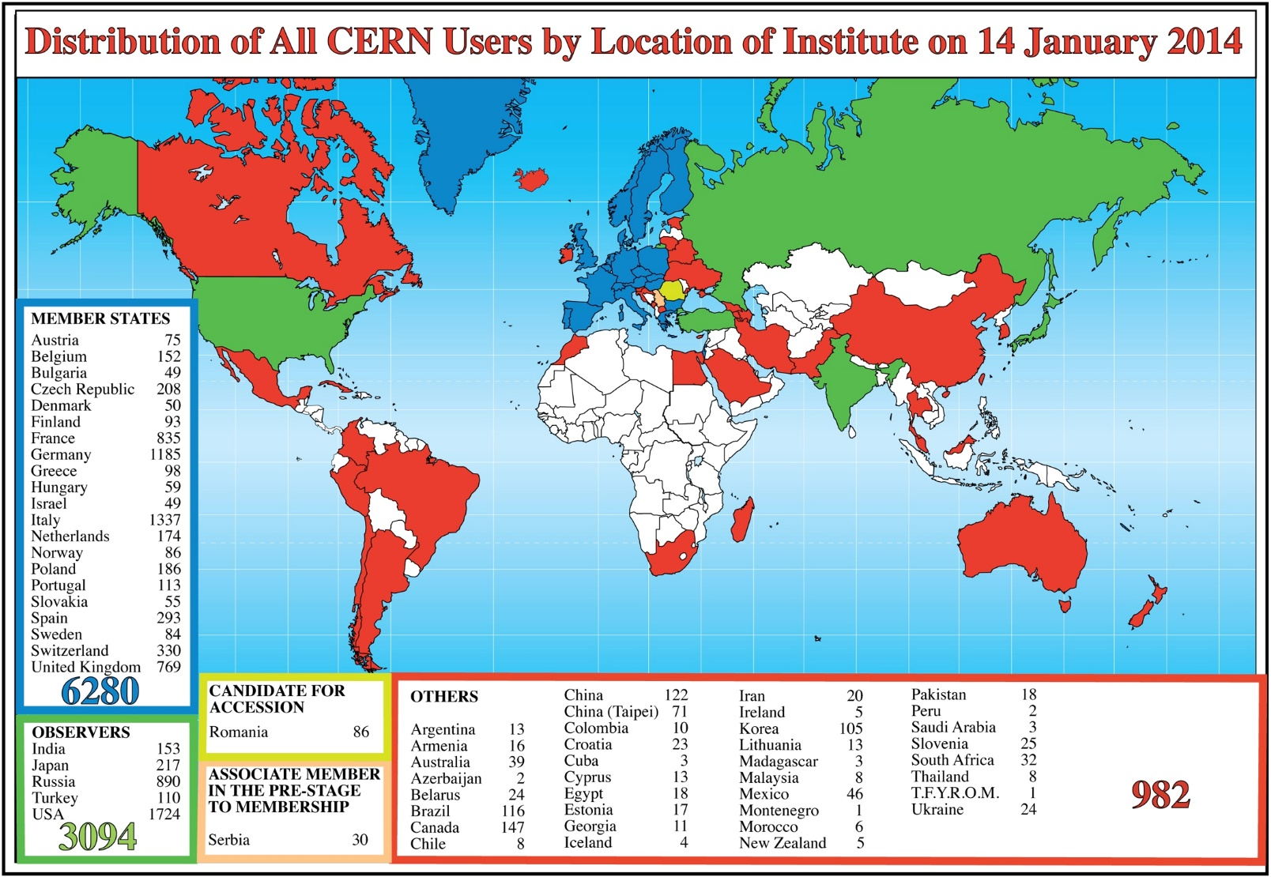
CERN Users – A World Wide Community

Slide 4
LHC Computing is a World Wide Federation
Tier 0 (CERN)
  Data recording
  Initial data reconstruction
  Data distribution
  Tier 1 (11 + KISTI,Korea In Progress)
  Permanent storage
  Re-processing
  Analysis
  10Gbit/s links
  Tier 2 (~150 centres)
  Simulation
  End-user analysis
  Overall
  Approx 160 sites, 39 countries
  300,000 cores
  200PB storage
  2 million jobs/day
Tier-2 sites
(about 150)
Tier-1 sites
- - - - 10 Gbit/s links

Slide 5
How Could CERN & WLCG Use Federated Clouds?
Revise computing models
  More flexibility than current hierarchical approach
  Address software sustainability
Identity federation
  Single account and password usable in other clouds
  Managed by your home institute
Resources on demand within pledges
  Project based accounting and quotas
  Common APIs for experiment workflows
Competitive marketplace between Private, Public or Hosted clouds
  Need to consider all cost factors (including networking and support)

Slide 6

CERN OpenLab in a Nutshell
A science – industry partnership to drive R&D and innovation started in 2001
Evaluate state-of-the-art technologies in a challenging environment and improve them
Test in a research environment today what will be used in many business sectors tomorrow
Train next generation of engineers/employees
Disseminate results and outreach to new audiences

Slide 7

The Future For Federation
@chriswiggy
www.rackspace.co.uk/devops
Chris Jackson - Rackspace

Slide 8
Our CERN OpenLab Project Summary
Explore the feasibility of federation of OpenStack clouds
Demonstrate federation of:
  Rackspace Private to Rackspace Public
  Rackspace Private to 3rd Party OpenStack
  Rackspace Public to 3rd Party OpenStack
Delivered:
  Rackspace Private to 3rd Party OpenStack
  De-Scoped Public Cloud due to a delay in our Keystone v3 launch
RAX Public
CERN Private
RAX Private

Slide 9
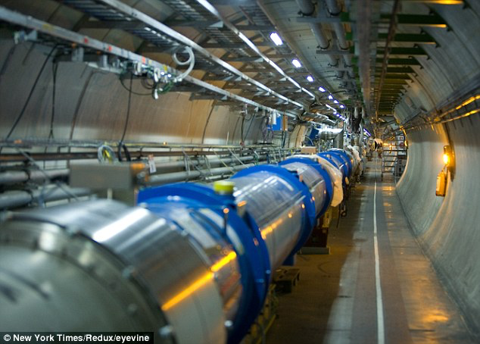
Working With CERN
Shared passion for Open Source
A great partner and ally
Full perspective of problems
Aligned a community
Learned about BIG Big Data
Full geek out in the LHC!

Slide 10

Why Federate?
Notes:
It is becoming increasingly apparent that most organizations will need to use multiple clouds to effectively serve the range of workloads they will run. Whether they want a blend of low-cost, high-performance, secure or optimized for things like GPU work.
However, even in the current phase of cloud adoption, we are seeing the complexity businesses are facing to integrate just one cloud into their business. Federation is an opportunity to re-use that initial integration for future clouds you want to run your business on, making multi-cloud a business benefit choice rather than a business cost one.

Slide 11
What Do We Want To Enable?
Identity is just step one…
Imagine if:
  You could define multi-cloud in a Heat template
  Glance images we’re available to all your endpoints
  Business rules could define where work was done
  Scheduling was done based on cost or features
What if you could:
  Resell spare capacity in your cloud?
  Build spot trading platforms for cloud capacity?
FEDERATION COMPLETES THE COMMODITIZATION OF INFRASTRUCTURE
Service Catalogue
Template Repos
Rules Engine
ORCHESTRATION
Cloud 1
Cloud 2
…
Cloud n
IDENTITY & REPORTING
Image Library
Identity Provider
Quota Logging

Slide 12
What Are We Doing Next?
Discussing OpenLab 2015 with CERN
  Proof of Concept for Federated Heat Templates
  Glance Image availability to all federated endpoints
  Discuss options and impact of service catalogue aggregation
  Aim for code to be available in Kilo release
  LOOKING FOR ENTHUSIASTS AND INTERESTED PARTIES TO JOIN US!

Slide 13
Technical Deep Dive
Marek Denis - CERN

Slide 14
Hybrid Cloud & Federation
  As a user I want to use my single set of existing credentials to access services across multiple clouds.

Slide 15


Hybrid cloud & Federation
Single local account
Multiple cloud services
Service Provider
(remote cloud)
TRUST
TRUST
Service Provider
(remote cloud)
TRUST
Service Provider
(remote cloud)
Identity Provider
(corporate LDAP/SQL)
TRUST
Service Provider
(remote cloud)

Slide 16
Federation In Icehouse
Design Flows
  Based on open standard federated protocol SAML2
  Service Provider - OpenStack Identity Service (Keystone)
  Identity Provider - SAML2 compatible Identity Management service
  Authentication and authorization split
  IdP has information about the user, not Keystone
  Federated users are ephemeral
Requirements (OpenStack)
  >=OpenStack Icehouse
  >=python-keystoneclient 0.11.0
  >=python-openstackclient 0.5
  Identity API v3
Identity Provider
(authN)
-Microsoft ADFS
-IBM FIM
-Shibboleth IdP
Service Provider (authZ)
Keystone

Slide 17

Cloud Federation – How?
Join or create your federation (administrative work involved)
Exchange Service Providers’ and Identity Providers’ metadata
Configure Apache webserver and Shibboleth Service Provider (NEW)
Enable federation extension in Keystone (NEW)
Prepare:
  projects/domains
  groups
  create and/or assign roles to projects/domains and groups
Add & Configure: (NEW)
  Trusted Identity Providers
  Mappings
  Protocols

Slide 18
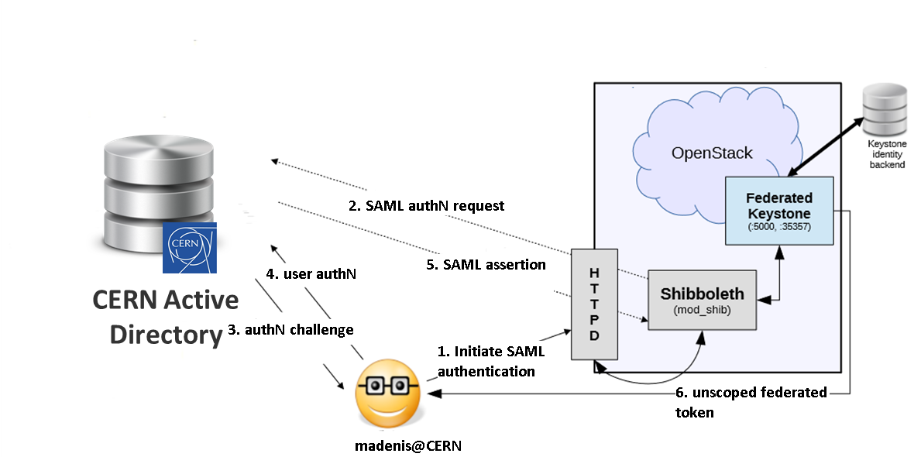
Federated Authentication
No user in the cloud backend
Dynamic assertion processing
User’s roles are resolved by group membership
Once authenticated, an unscoped token is returned with a list of groups user is a member of
Token must be scoped to a project or domain
CADF as a way for accounting
(Still) No user in the cloud backend
Identity Provider

Slide 19
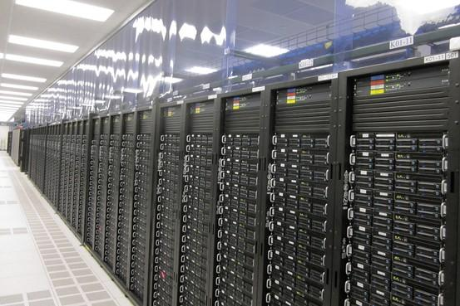



Real Life Use Case
IdP: CERN
Mapping: CERN
Protocol: saml2
Peers metadata exchanged (shibboleth)
Projects: developers
Groups: developers
ROLES
group: developers
project: developers
GROUPS:
developers: admin
CERN Active Directory
TRUST
USERS:
madenis
USERS:
admin

Slide 20
DEMO/VIDEO

Slide 21


Slide 22
Mapping
Modules like mod_shib/mod_mellon/others do the hard work for us:
  parse SAML/OpenID Connect/ABFAB assertion
  validate the signature
  store the assertion attributes in environment
Keystone parses it’s own environment and applies mapping rules on it

Slide 23

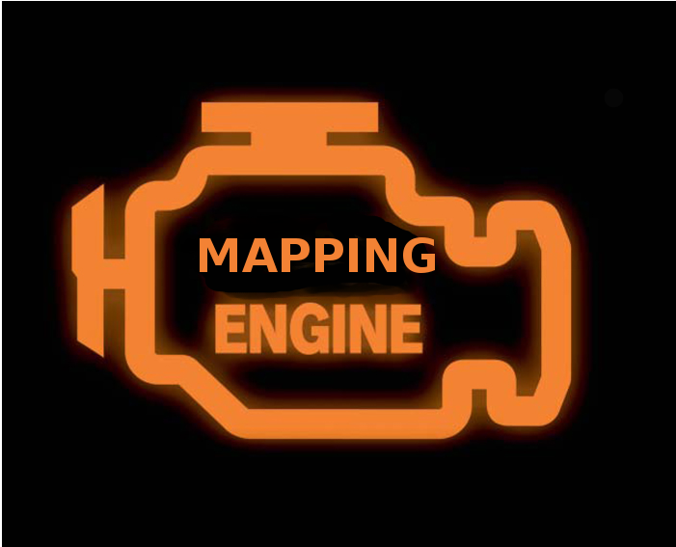
Mapping Engine
Saml
Assertion
Keystone credentials
LOGIN: madenis
LANGUAGE: EN
DEPARTMENT: IT/OIS
FULLNAME: Marek Denis
BLDGS:31;513;40
[
{ "local”:
[ { "user": { "name”: "{0}" } } ],
"remote”:
[ { "type": "LOGIN" } ]
},
{ "local”:
[ { "group": { "id": „devs" } } ],
"remote”:
[ { "type":“BLDGS”,"any_one_of":["1", "2", "31"] } ]
}
]
{
“user_id”: “madenis”
“groups”: [“devs”]
}

Slide 24
Mapping Rules – A Closer Look
Rule
[
{
"local": [
{ "user": {"name": "{0}"} }
],
"remote": [
{ "type": "ADFS_LOGIN” }
]
},
{
"local": [
{
"group": { "id": "developers” }
}
],
"remote":[
{
"type": "ADFS_DEP”,
"any_one_of": ["IT/OIS"]
},
{
"type": "ADFS_LANGUAGE",
"any_one_of": ["PL", "EN"]
}
]
}
]
Map 0th attribute from ‘remote’
Use ADFS_LOGIN
Rule
Assign group “developers”
If ADFS_DEP is “IT/OIS”…
.... and ADFS_LANGUAGE is either “PL” or “EN”

Slide 25
Mapping Rules
JSON
List of rules
Rule is a dictionary
Each rule has two items:
  local
  remote
Rules can be concatenated
One rule must map user id
  Required for federated users identification
  Keystone fails with HTTP 401 (Unauthorized) if username is not defined
Assertion attributes can be ‘;’ separated (e.g. list of users groups)
Mapping keywords: any_one_of, not_any_of
Mapping rules must be changed to reflect group/projects changes
{
"local": [
{ "user": {"name": "{0}"}},
{"group": { "id": "developers"}}
],
"remote":[
{ "type": "ADFS_DEP",
"any_one_of": ["IT/OIS"]
},
]
}

Slide 26
Mapping Rules – Good Practices
An Identity Provider can use only one mapping rules list
A mapping rules list can be used for many Identity Providers
It is a protocol that ties mapping and Identity Provider together
Make one rule for mapping unique username
  user_id is the only way to distinguish your users and apply some accounting/metering/billing on them
  make sure ids are unique across your IdPs

Slide 27
Identity Federation Is Not Perfect (yet)
One federated token per cloud
Apache modules to handle federated protocols
No inter-cloud metering, image sharing, virtual networks
Come and help with development, testing, evangelizing, documenting!

Slide 28
What Next?
Keystone2Keystone
Enhance mapping engine
Better token handling in keystoneclient
Explore OpenStack services?
  nova
  glance
  neutron
  heat

Slide 29
PLEASE JOIN OUR FEDERATION DESIGN SESSION!
Wednesday, Nov 5th
16:30 – 17:30
Corot

